Slide 1
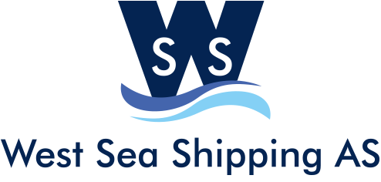
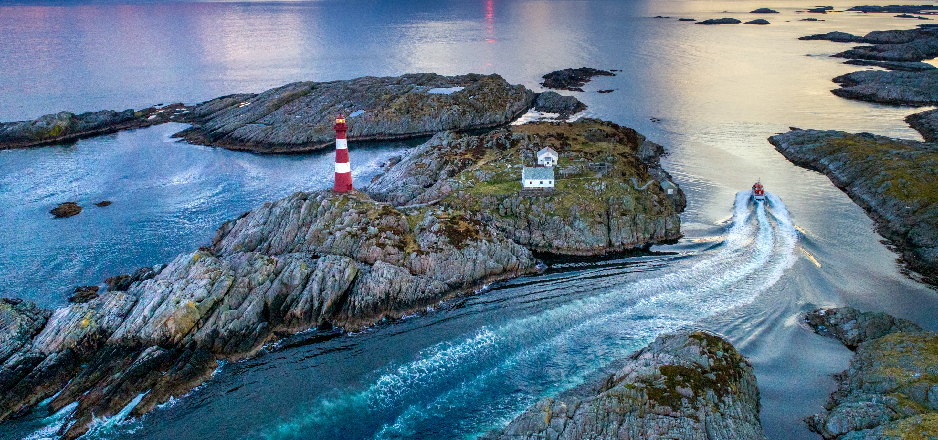
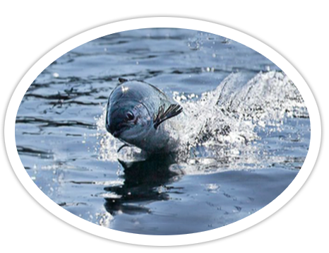
Salmon tour
Experience the magic streams with a taste of salmon.
Join us on this unique tour in the spectacular coast of Bergen county with its fantastic coastal landscape. We travel by boat, under bridges and through the magic streams to the salmon farm of Skjergårdsfisk where you will get a guided tour at the visitor center, visit a fish cage to look at live salmon, and also get at taste of this delicous piece of Norwegian history.
Departure: Knarvik Kai / Alver kai.
Duration: 3 hours
Price: 530 nok/pax +12%vat (minimum 25 pax)
Booking: tel 0047 406 77 249 / www.westseashipping.com

Slide 2
GET CLOSE TO THE SALMON
Get a unique and tasteful insight into the world of Norwegian salmon farming at Skjærgårdsfisk Display Centre. Follow the hole life cycle of the salmon. Get up close to the salmon alive. You simply cannot get closer to the salmon than this!
THE MAGICAL STREAMS
It may look like a river at some times, tight and narrow, but it is the magical streams of western Norway with its deep blue water and bright small green islands and shores.
Come experience it with us!
A UNIQUE EXPERIENCE FEW HOTELS CAN OFFER.
Salmon safari is a collaboration between Westland and Alver Hotel together with West Sea Shipping. A unique experience few other hotels can offer. Staying at one of the hotels? Book your safari there!
THE MOST WESTERN POINT OF NORWAY.
On this magical journey you will also get to see Vardetangen, the most western point of Norway. A beautiful and popular destination for people who enjoy walking and recreation outdoors.

